Slide 1
Two-phase westward encroachment of Basin and Range extension into the northern Sierra Nevada
Surpless et al., 2002
GEOL 730
Yair Franco

Slide 2
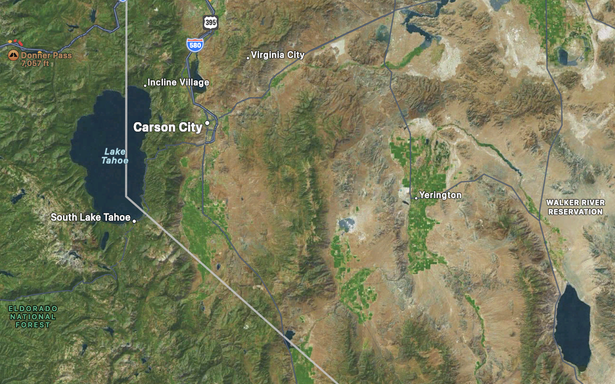
^ Reno
Pine Nut
Mountains
Carson Range
Singatse Range
Wassuk Range

Slide 3
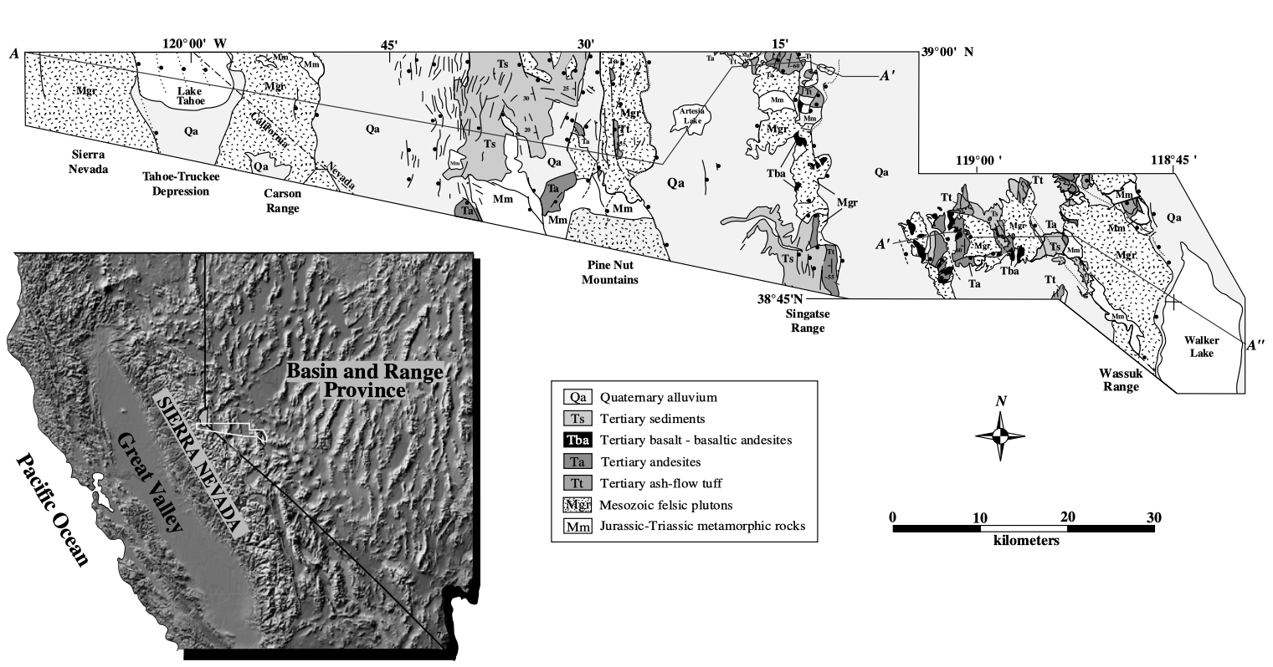
Motivation & Prior Knowledge
Transition from unextended to extended crust provides an opportunity to study the evolution of transition

Slide 4
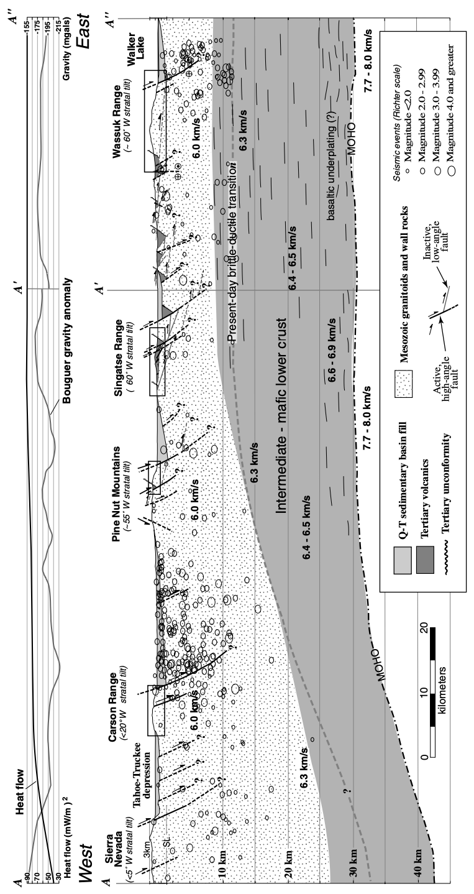
Change in Moho depth, crustal thickness, earthquake depth, decrease in heat flow, all suggest a boundary between Sierra and Basin

Slide 5
Crustal exposures are more exposed eastward
Suggests extension is younger westward
Exposures allow fission track dating

Slide 6
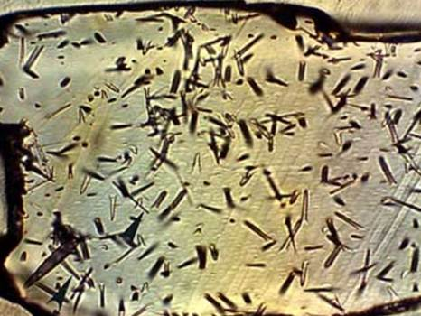
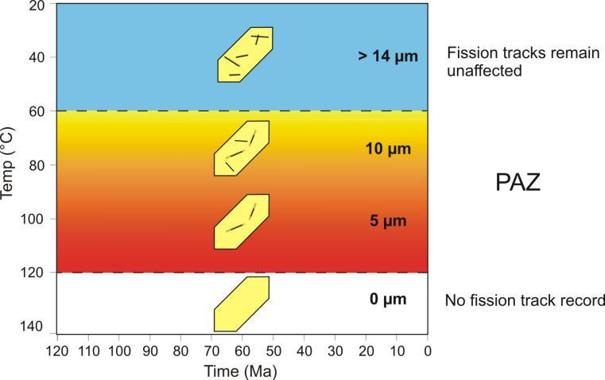
Fission Track Dating
Decay of ²³⁸U leaves damage tracks on apatite
Tracks only preserved under 110°C (partially at 60-110°C)
Expect apparent age to increase towards the paleosurface
Partial tracks help estimate temperature at different depths

Slide 7
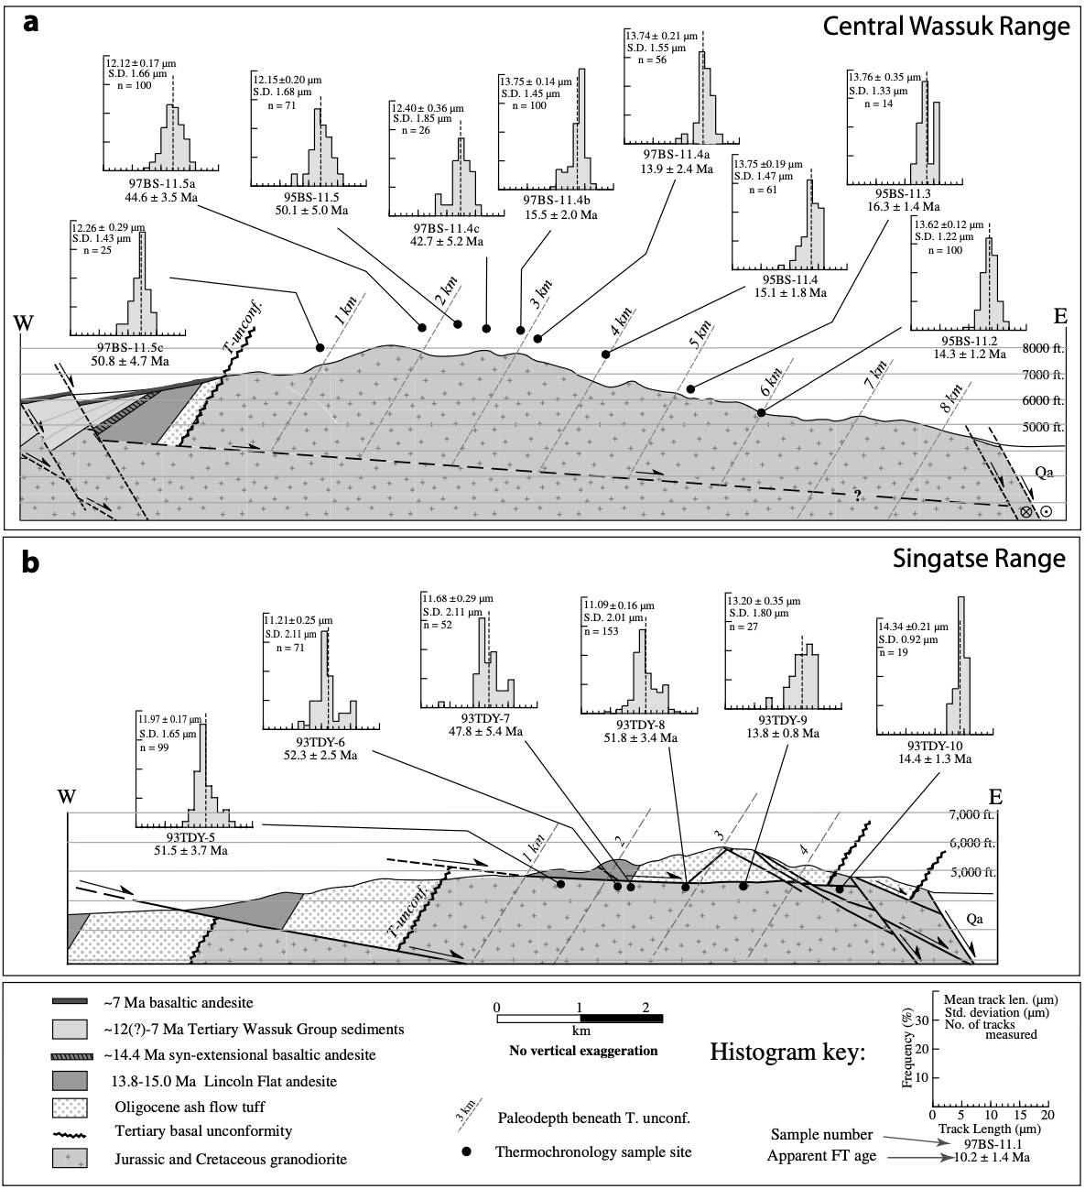
Wassuk and Singatse Ranges
Strata tilted >60° by faulting and extension
Fission track ages decrease down the strat. sequence
110°C isotherm defined by sudden apparent age change

Slide 8
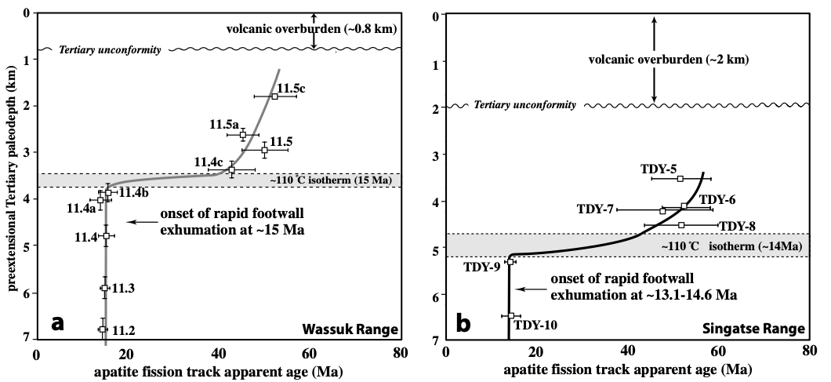
Wassuk and Singatse Ranges
110°C isotherm defined by sudden change in apparent age
Exhumed about 15 Ma

Slide 9
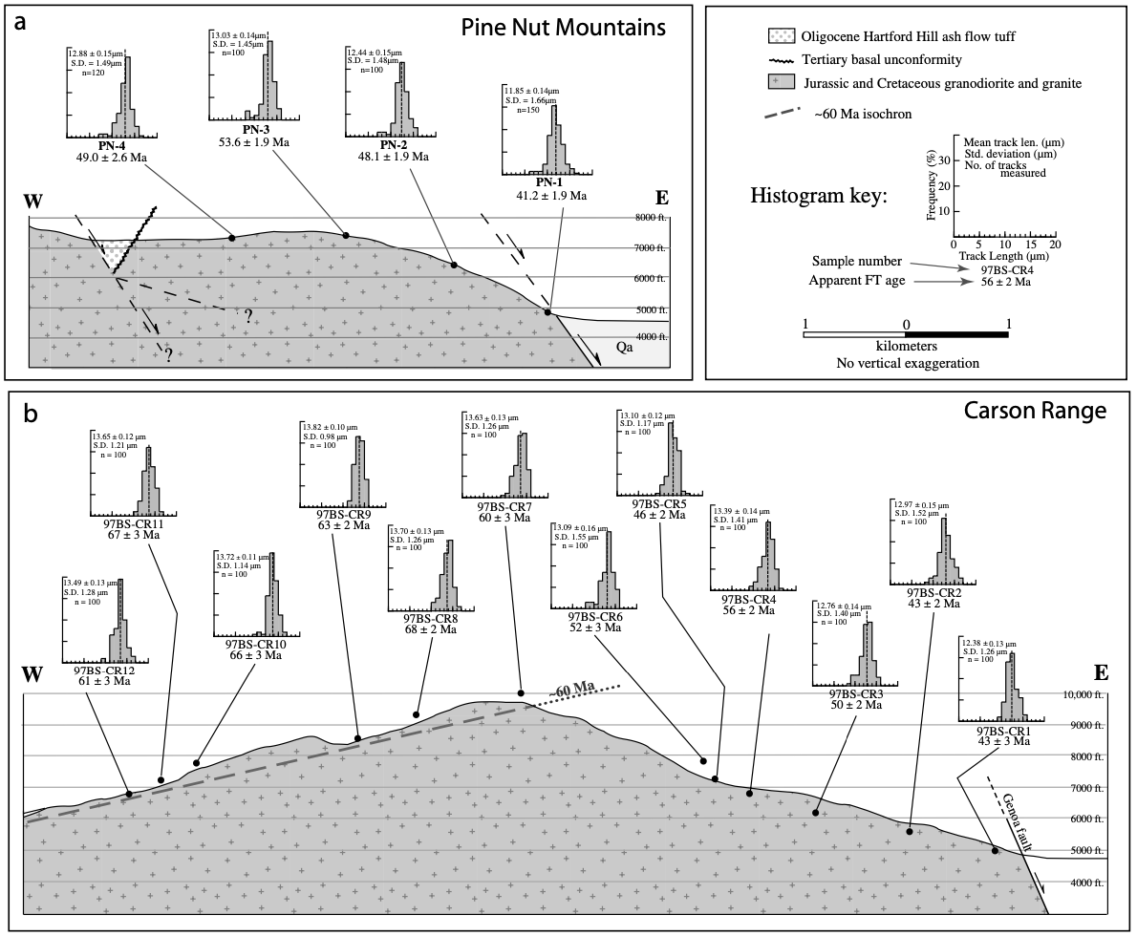
Pine Nut, Carson Range
Around 15° of tilt, lower than east
Faulting and tilting suggest another major extension
Old isotherm harder to find as erased fission tracks are not exposed

Slide 10
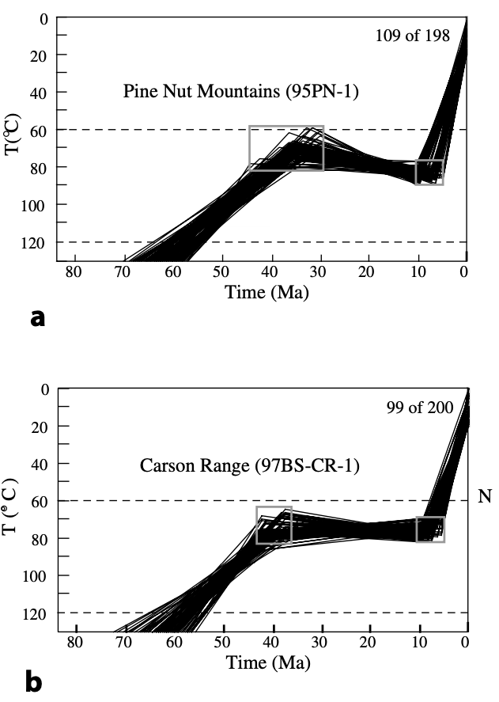
Pine Nut, Carson Range
Monte Carlo method using partially annealed tracks to estimate apparent ages at depth
Two periods of uplift seen:
Late Cretaceous erosion
<10 Ma major fault tilting and exhumation

Slide 11
Tahoe-Truckee
Very little evidence of extension and tilting west of Carson Range
Fault system west of Tahoe considered the boundary between Sierra Nevada and Basin and Range provinces
Present fault motion westward suggests the boundary is moving

Slide 12
Conclusions
Two recent stages of encroachment of Sierra-Basin boundary
First: ~15 Ma, second: <10 Ma
Encroachment still happening today

Slide 13
Abstract
Westward encroachment of Sierra-Basin transition zone
Starting in Miocene
Extension magnitude increases east
Rapid footwall cooling due to extension ~14-15 Ma
Younger extension westward (10-3 Ma)
Incipient faulting west of Tahoe-Truckee
Implied presence of the 14-15 Ma “extensional breakaway zone”
Estimated high Miocene geothermal gradient > crustal weakening
Two stage encroachment since the middle Miocene

Slide 14
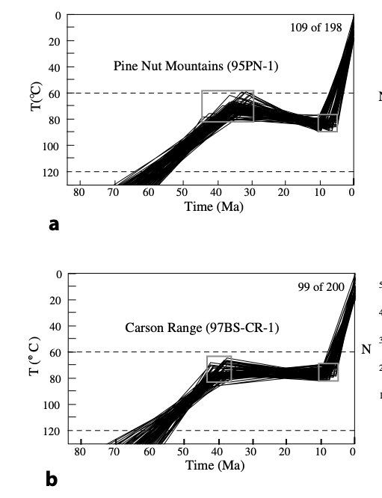
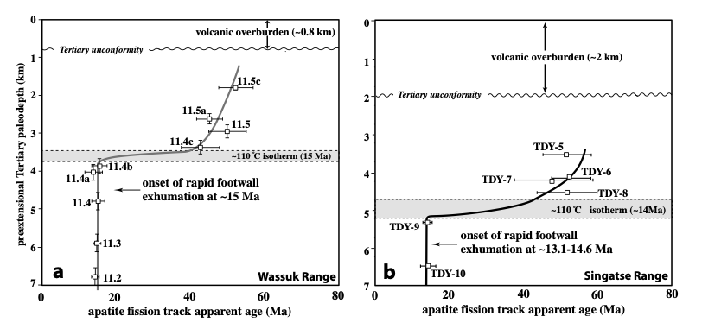
Westward encroachment of Sierra-Basin transition zone
Starting in Miocene
Extension magnitude increases east
Rapid footwall cooling due to extension ~14-15 Ma
Younger extension westward (10-3 Ma)
Incipient faulting west of Tahoe-Truckee
Implied presence of the 14-15 Ma “extensional breakaway zone”
Estimated high Miocene geothermal gradient > crustal weakening
Two stage encroachment since the middle Miocene
Pine Nut Fission Track
Central Wassuk and Singatse Range Fission Track
Carson Range Fission Track

